Slide 1
Linear/OLS Regression

Slide 2
What is Regression?
A way of explaining the value of one variable from another.
Linear, straight-line relationship
Fits the line through the correlation/scatterplot
Notes:
Equation is in form of straight line

Slide 3
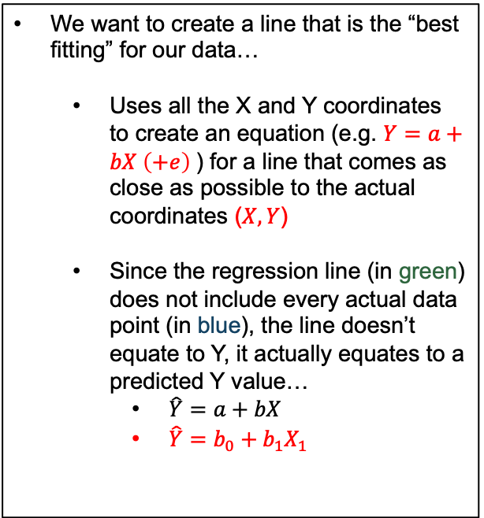
Ordinary Least Squares
We want to create a line that is the “best fitting” for our data…
Uses all the X and Y coordinates to create an equation (e.g. $Y=a+bX \left(+e\right)$) for a line that comes as close as possible to the actual coordinates ($X,Y$)
Since the regression line (in green) does not include every actual data point (in blue), the line doesn’t equate to Y, it actually equates to a predicted Y value…
$\hat{Y}=a+bX$
$\hat{Y}=b_{0}+b_{1}X_{1}$
Notes:
Y hat means predicted Y values, not people’s actual Y values

Slide 4
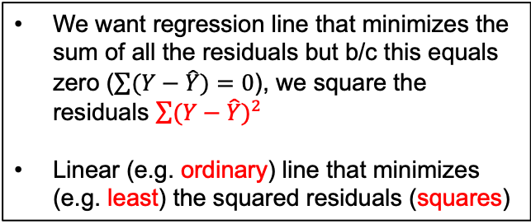
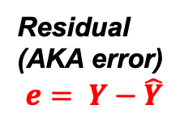
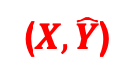
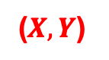
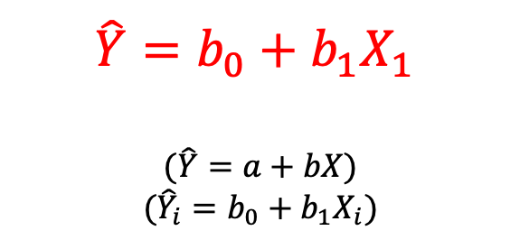
Ordinary Least Squares
$$\hat{Y}=b_{0}+b_{1}X_{1}$$
$$(\hat{Y}=a+bX)$$
$$({\hat{Y}}_{i}=b_{0}+b_{1}X_{i})$$
($X,Y$)
Residual (AKA error)
$$e= Y−\hat{Y}$$
($X, \hat{Y}$)
We want regression line that minimizes the sum of all the residuals but b/c this equals zero ($\sum{(Y−\hat{Y})}=0$), we square the residuals $\sum{{(Y−\hat{Y})}^{2}}$
Linear (e.g. ordinary) line that minimizes (e.g. least) the squared residuals (squares)
Notes:
Y hat means predicted Y values, not people’s actual Y values

Slide 5
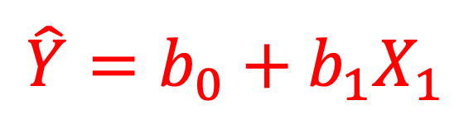
Describing a Straight Line
b₀ (or a)
Y intercept (value of Y when X = 0)
Point at which the regression line crosses the Y-axis
b₁
Regression coefficient for the predictor
Amount of change in Y for each one-unit change in X
Slope of the regression line
Direction/Strength of Relationship
$$\hat{Y}=b_{0}+b_{1}X_{1}$$
Notes:
Yhat = a + bX + e (e, epsilon is error… everything else that can possibly explain value of Y, not accounted for by )
Plug in values (slope)

Slide 6
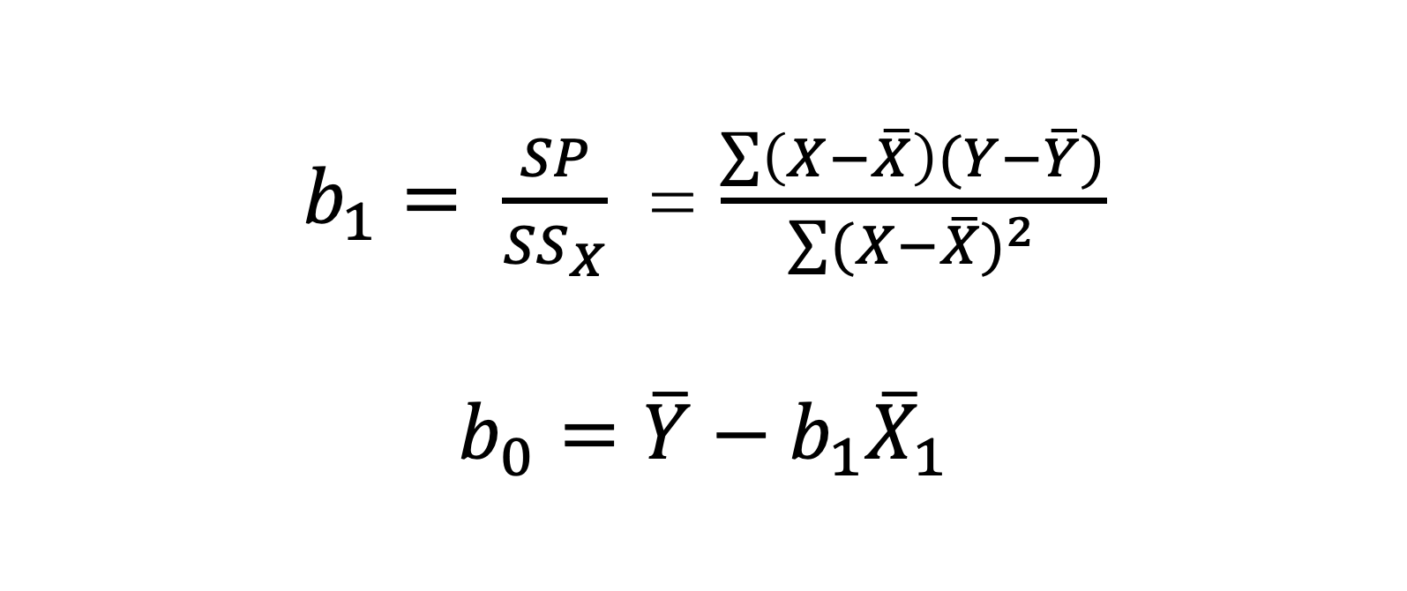
Calculating the Straight Line
$b_{1}= \frac{SP}{{SS}_{X}}$ = $\frac{\sum{\left(X−\overline{X}\right)(Y−\overline{Y})}}{\sum{{(X−\overline{X})}^{2}}}$
$$b_{0}=\overline{Y}−b_{1}{\overline{X}}_{1}$$

Slide 7
How Good is the Model?

Slide 8
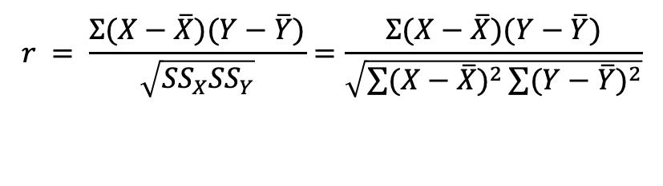
How Much Variance in Y does Model Explain: R²
R²
The proportion of variance accounted for by the regression model.
The Pearson Correlation Coefficient Squared
$$r = \frac{Σ(X−\overline{X})(Y−\overline{Y})}{\sqrt{{SS}_{X}{SS}_{Y}}}=\frac{Σ(X−\overline{X})(Y−\overline{Y})}{\sqrt{\sum{{(X−\overline{X})}^{2}}\sum{{(Y−\overline{Y})}^{2}}}}$$
Notes:
== SP^2 / SSx*SSy

Slide 9
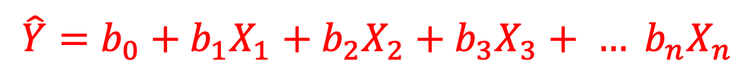
Multivariate OLS
When we want to
measure multiple, competing variables that represent different theories or hypotheses… and
control for spuriousness (e.g. some unexplained third variable that could explain the relationship between X and Y)
We include multiple independent variables:
$$\hat{Y}=b_{0}+b_{1}X_{1}+b_{2}X_{2}+b_{3}X_{3}+ … b_{n}X_{n}$$

Slide 10
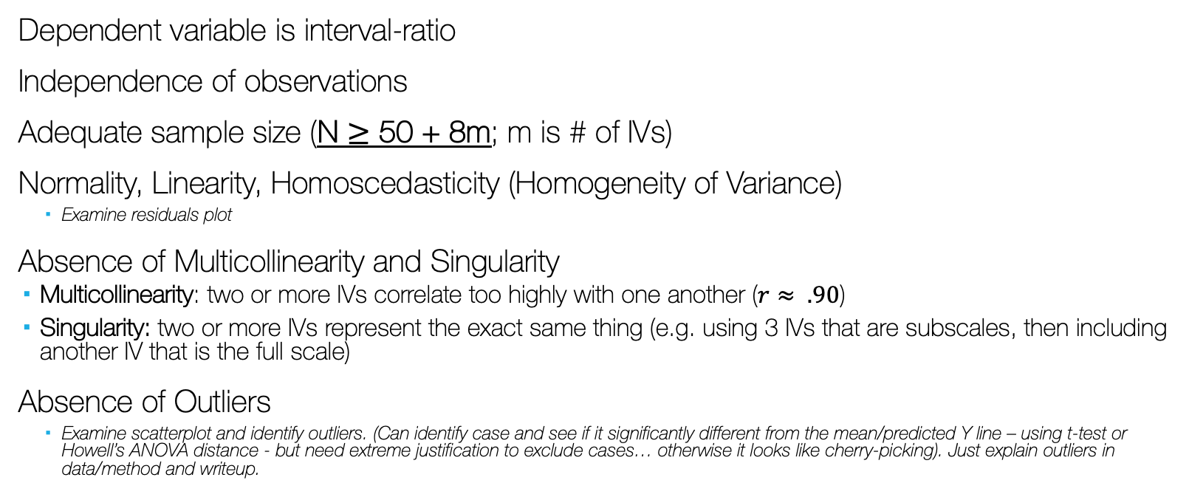
Linear/OLS Assumptions
Dependent variable is interval-ratio
Independence of observations
Adequate sample size (N $≥$ 50 + 8m; m is # of IVs)
Normality, Linearity, Homoscedasticity (Homogeneity of Variance)
Examine residuals plot
Absence of Multicollinearity and Singularity
Multicollinearity: two or more IVs correlate too highly with one another ($r≈ .90$)
Singularity: two or more IVs represent the exact same thing (e.g. using 3 IVs that are subscales, then including another IV that is the full scale)
Absence of Outliers
Examine scatterplot and identify outliers. (Can identify case and see if it significantly different from the mean/predicted Y line – using t-test or Howell’s ANOVA distance - but need extreme justification to exclude cases… otherwise it looks like cherry-picking). Just explain outliers in data/method and writeup.

Slide 11
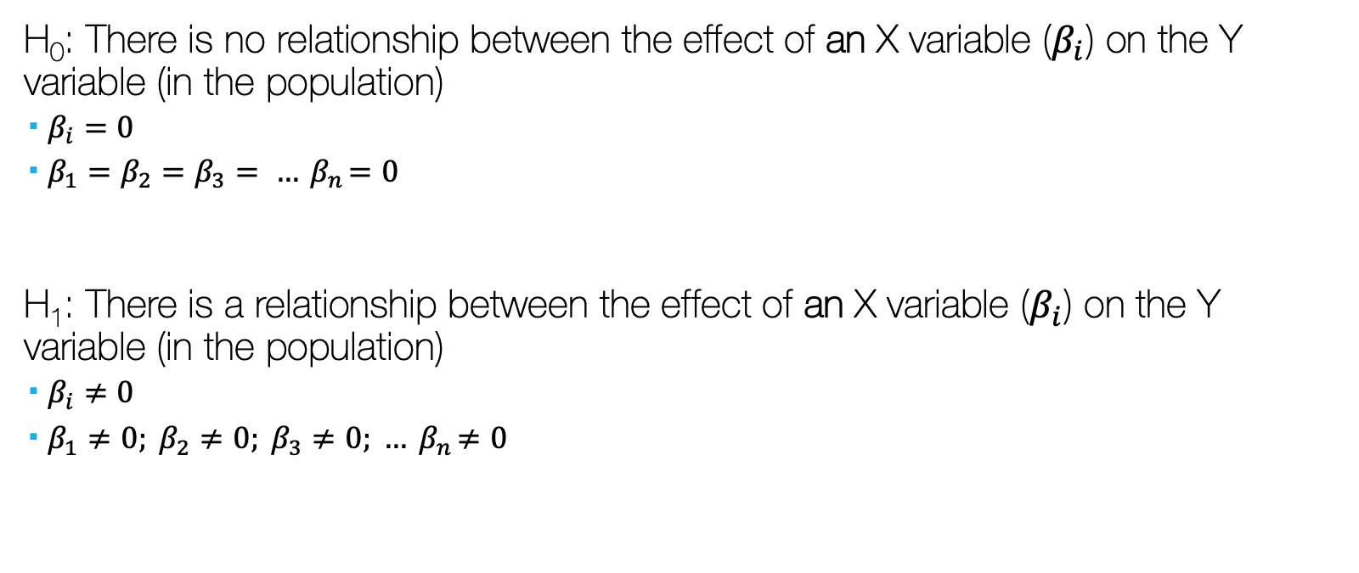
Linear/OLS (Hypotheses)
H₀: There is no relationship between the effect of an X variable ($β_{i}$) on the Y variable (in the population)
$β_{i}=0$
$β_{1}=β_{2}=β_{3}= …{ β}_{n}=0$
H₁: There is a relationship between the effect of an X variable ($β_{i}$) on the Y variable (in the population)
$β_{i}≠0$
$β_{1}≠0; β_{2}≠0; β_{3}≠0; …{ β}_{n}≠0$

